Slide 1


Team Details
  Team name: Neural Nuggets (Teach Milo)
  Team leader name: Kyaw Kyaw Oo
  Problem Statement: Personalized learning by teaching an AI student
Notes:
Team identity and project name from the supplied v6 presentation.

Slide 2

Note: Please download this template to make your edits and submit the final version.
To download, go to File > Download > Microsoft PowerPoint (.PPTX). Kindly refrain from sending edit requests.

Slide 3
Brief about the idea
Teach Milo
A web app where learners teach a curious AI student using their own study material.
Who it serves
Students and self-learners who want to practise explaining and applying a concept.
How it works
Milo asks about gaps, presents a misconception to correct, and offers a fresh application task.
Working prototype on Google Cloud with Gemini. Guests can start without an account.
Notes:
Source: supplied Teach Milo v6 deck and https://github.com/kyawoo-23/teach-milo. Product claims describe the prototype, not measured learning gains. Learning benefits remain a product hypothesis pending learner evaluation.

Slide 4
Opportunities
How different is it from any of the other existing ideas?
How will it be able to solve the problem?
USP of the proposed solution
How it differs
The AI takes the student role. The learner explains material from their own notes instead of receiving a generated lesson to read.
How it addresses the problem
Questions and deliberate misconceptions expose gaps. An independent check asks the learner to apply the idea in a new situation.
USP
Teaching, an independent application task, and feedback that quotes the learner’s own explanation in one session.
Notes:
Source: supplied Teach Milo v6 deck and https://github.com/kyawoo-23/teach-milo. Product claims describe the prototype, not measured learning gains. Category comparison, not a market-first claim or measured competitor comparison.

Slide 5
List of features offered by the solution
Functional features
Non-functional features
Your own material
Validated AI output
Upload PDF, DOCX, PPTX or TXT, or paste notes.
Schemas check replies. The server verifies calculations.
Review and prepare
Protected data and secrets
Correct extracted text. Choose focus, depth and language.
Server-side keys, hashed passwords, 7-day data expiry.
Teach in chat and on boards
Reusable teaching boards
Explain ideas and correct Milo’s misconception.
Activities, concept maps, matching, tables and sketches.
Independent check and report
Language and appearance
Try a fresh task and inspect cited feedback.
5 interface languages, 9 teaching languages, light/dark.
Notes:
Source: supplied Teach Milo v6 deck and https://github.com/kyawoo-23/teach-milo. Product claims describe the prototype, not measured learning gains. No accessibility certification or formal reliability claim. Original uploaded file bytes are not retained.

Slide 6
Process flow diagram or Use-case diagram
1 Add material
Upload or paste notes
2 Review source
Correct extracted text
3 Prepare lesson
Choose focus and depth
6 Learning report
Evidence and next steps
5 Independent check
Apply to a fresh task
4 Teach Milo
Explain and correct
Teaching can continue until the evidence supports readiness. The independent check is optional.
Learners can end a session at any time and receive feedback.
Notes:
Source: supplied Teach Milo v6 deck and https://github.com/kyawoo-23/teach-milo. Product claims describe the prototype, not measured learning gains. Editable process flow. Readiness uses the cumulative evidence ledger, not Milo’s tone.

Slide 7
Wireframes/Mock diagrams of the proposed solution (optional)
Prepare a lesson
Teach Milo
Independent check
Upload a document
or paste your notes
Milo
Why does that happen?
You
Explain the relationship.
Try a fresh scenario
Apply the idea without
practice aids.
Lesson focus
Teaching language
Depth
Your reasoning…
Attach a teaching board
Prepare lesson
Write an explanation…
Submit explanation
Schematic layouts. Actual prototype screenshots appear on slide 11.
Notes:
Source: supplied Teach Milo v6 deck and https://github.com/kyawoo-23/teach-milo. Product claims describe the prototype, not measured learning gains. These are editable schematic wireframes. Wording is illustrative, not a usability result.

Slide 8
Architecture diagram of the proposed solution
Server: validates AI replies, checks readiness, and re-runs board and transfer calculations.
Gemini API
Lessons, chat, feedback
Browser
Learner interface
Cloud Run
Next.js app and APIs
Cloud Firestore
Material and sessions
Secret Manager
Server-side credentials
Cloud Build and Artifact Registry deploy the app to Cloud Run in Singapore.
Notes:
Source: supplied Teach Milo v6 deck and https://github.com/kyawoo-23/teach-milo. Product claims describe the prototype, not measured learning gains. Architecture from cloudbuild.yaml and src/server/model.ts. Gemini Developer API uses server-side key authentication. Native editable nodes and connections. This is not a load-test result.

Slide 9
Technologies to be used in the solution
Technology | Role in the prototype
Gemini and Google Gen AI SDK | Extract content and generate lessons, activities, chat and feedback
Next.js, React and TypeScript | Website and server API routes
Cloud Run | Host the containerized app in Singapore
Cloud Firestore | Store material, lessons, conversations and evidence with expiry
Cloud Build and Artifact Registry | Build and deploy the application container
Secret Manager | Keep API keys and authentication secrets on the server
Zod and calculation sandbox | Validate structured replies and verify numeric calculations
Notes:
Source: supplied Teach Milo v6 deck and https://github.com/kyawoo-23/teach-milo. Product claims describe the prototype, not measured learning gains. No claim of Vertex AI, Imagen, Veo, Translation API, BigQuery or Cloud Storage integration.

Slide 10
Estimated implementation cost (optional)
Free-tier inference: US$0 only for eligible use within the project’s actual quota.
Illustrative paid equivalent for Gemini 3.5 Flash-Lite, standard rates
Assumption / calculation | 1,000 illustrative sessions
12 calls × 1,500 input tokens per session | 18M input tokens × US$0.30/M = US$5.40
12 calls × 450 output tokens per session | 5.4M output tokens × US$2.50/M = US$13.50
Gemini API only | US$18.90 total, or US$0.0189 per session
Usage assumptions are illustrative. Output includes thinking tokens. Hosting, Firestore and
deployment charges are separate. The benchmark on slide 12 reports observed API usage.
Notes:
Published standard pricing verified 18 October 2026: https://ai.google.dev/gemini-api/docs/pricing#gemini-3.5-flash-lite . Free tier input/output are free within eligible quota. Standard paid input US$0.30/M, output including thinking US$2.50/M. Formula: 1,000 × 12 × 1,500 = 18M input, 1,000 × 12 × 450 = 5.4M output. The prior US$0.0269/session claim lacks supporting logs and is not retained as a measured session cost. No claim of actual monthly billing or higher account quotas.

Slide 11
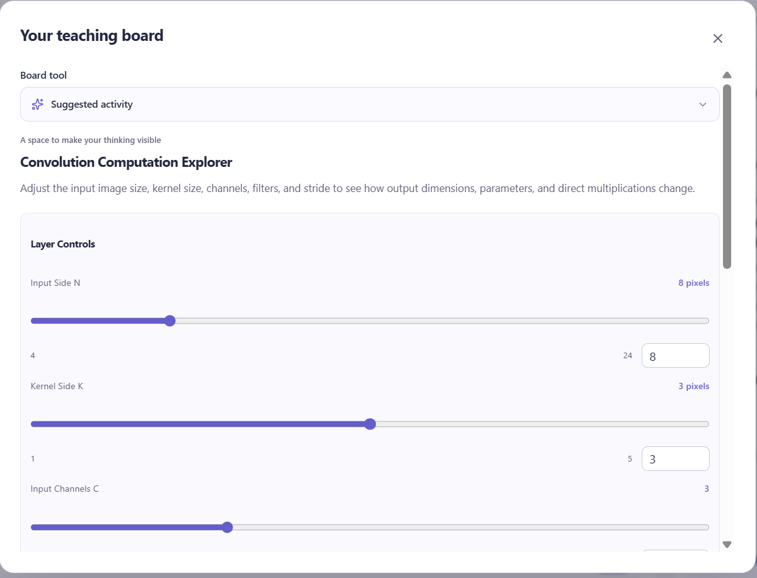
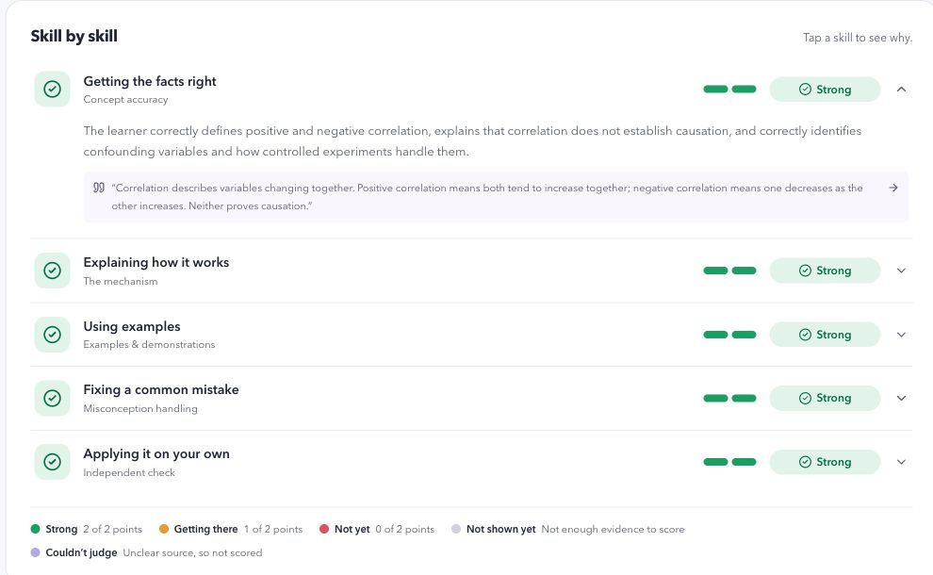
Snapshots of the prototype
Teach with a generated board
Review evidence-linked feedback
Actual prototype captures from the supplied deck, using sample learner answers.
Notes:
Original prototype screenshot assets reused from supplied v6 slides 12 and 16. The source deck describes production captures and agent-authored sample learner answers. These images demonstrate the workflow, not general accuracy, learning gains or latency.

Slide 12
Prototype Performance report/Benchmarking
gemini-3.5-flash-lite. Direct Gemini SDK calls, n=9, concurrency 1.
Workload | API OK | p50 / max latency | Input / output tokens (total)
lesson preparation | 3/3 | 5.20 s / 5.80 s | 5,793 / 5,008
teaching reply | 3/3 | 2.50 s / 2.70 s | 3,513 / 1,624
report evaluation | 3/3 | 4.07 s / 4.21 s | 3,849 / 3,918
Structured JSON: 9/9. Fixture checks: 9/9. Paid equivalent: US$0.02991 total.
Paced throughput: 2.76 successful calls/min with 20 s gaps. No capacity claim.
Constraints: active RPM/TPM/RPD and account tier unverified. No quota increase.
Free-tier charge is US$0 only if eligible. This run excludes app/HTTP latency, PDF OCR
and concurrent load. Fixture checks do not establish general AI accuracy.
18 Oct 2026. macOS arm64, Node 26.11.1. Full environment and method in notes. Raw logs in project.
Notes:
MEASURED GEMINI COMPONENT BENCHMARK
Run: 2026-10-18T04:41:57.323Z to 2026-10-18T04:45:12.914Z.
Environment: darwin arm64, Apple M4 Pro, 24 GiB RAM, Node v26.11.1, @google/genai 2.28.0. Local client to hosted Gemini Developer API. Not an app/HTTP benchmark. Model gemini-3.5-flash-lite. Working tree dirty at git commit b86c3135b3d19086170d1f77bf3b5d184cc3f886. Exact fixture SHA-256 ced481d5dc117cfd8a7d2319a38341a866fba7e59e462b50575bc4e006e7f3a2.
Methodology: Three repetitions per workload with identical synthetic English fixtures and production prompts/schema/settings. One request at a time, 20s minimum after completion. No retry or warmup. Stop on quota/auth errors. Latency includes request serialization, network and complete SDK response, excludes validation and pacing. Nearest-rank p50, min/max and descriptive paced throughput, no capacity claim. Correctness checks are narrow fixture checks, not general AI accuracy.
Workloads use repository PREPARE_PROMPT, STUDENT_PROMPT and EVALUATE_PROMPT, real Zod response schemas, and one fixed English constant-speed fixture from tests/fixtures.ts. Three independent repetitions per workload, interleaved. Lesson checks validate source IDs and board compilation. Teaching checks apply normalizeStudentReply then validateStudent. Report checks validate quote grounding and expected accuracy/transfer-reasoning scores for the synthetic correct answer. No human factual-accuracy review, no measured learning outcome.
Tokens: totals per workload from SDK usageMetadata. Output column = candidatesTokenCount + thoughtsTokenCount. Paid equivalent = uncached input × $0.30/M + cached input × $0.03/M + output including thinking × $2.50/M. Price source https://ai.google.dev/gemini-api/docs/pricing#gemini-3.5-flash-lite, verified 18 October 2026. This is not a measured full-session cost or actual bill. Free inference is conditional on free-tier eligibility.
Quota constraints: current configured key only, account billing tier and active numeric RPM/TPM/RPD not accessible from supplied materials. No higher limits requested. SDK retries disabled, stop on 429/auth errors. Actual quota failures: 0 failed calls in this run. Google applies limits per project across RPM, input TPM and RPD. RPD resets midnight Pacific. View actual limits in AI Studio: https://ai.google.dev/gemini-api/docs/rate-limits . App daily guard is bypassed by this isolated script.
Latency: nonstreaming request to complete SDK response using performance.now(), includes network, excludes post-response validation and pacing. p50 uses nearest rank. Max shown instead of unreliable p95 at n=3. Throughput is successful requests divided by full elapsed wall time including explicit 20s gaps and local validation/setup. It is descriptive, not saturation capacity. Cold/warm network effects not isolated. Timeout 120s, temperature 0.35, output cap 10000.
Raw evidence directory: /Users/kko/VSCode/Kko/TeachBack AI /artifacts/benchmarks/2026-10-18T04-41-57-323Z. Reproduce: node --conditions=react-server --import tsx scripts/benchmark-gemini.ts .
Limitations: Direct Gemini SDK component benchmark. Excludes browser, Next.js, HTTP route, Firestore, full session, PDF OCR, repair calls, concurrent load, and learning outcomes. Tiny repeated single-topic synthetic sample. No general factual-accuracy or learning-gain estimate. Account tier and project quotas not verified in AI Studio. Results use current API access without requesting higher limits. Paid equivalent uses published standard rates, not billed cost or measured session cost. Free charge is conditional on free-tier eligibility. The app's global daily model-call guard is bypassed because this script calls Gemini directly. No production records are created.
Improvement: add HTTP end-to-end instrumentation, PDF OCR cases, broader accuracy labels, repair/retry telemetry and quota-paced multi-session trials.

Slide 13
Additional Details/Future Development (if any)
Available today
Gemini builds activities from a catalog of 17 reusable components. Learners can attach a board to their written explanation.
Next: measure the complete learner journey
Instrument app response times, PDF OCR, retries and tokens per completed session. Repeat across document sizes and teaching languages.
Next: validate learning and expand practice
Run a learner pilot with independent application tasks. Add focused follow-up activities and recurring practice using the shared activity catalog.
Notes:
Source: supplied Teach Milo v6 deck and https://github.com/kyawoo-23/teach-milo. Product claims describe the prototype, not measured learning gains. Proposed work, not deployed or measured outcomes. Benchmark limitations and improvements are recorded on slide 12. No subject-specific modules proposed.

Slide 14
Provide links to your:
GitHub Public Repository
Demo Video Link (3 Minutes)
Final Product Link
GitHub Public Repository
https://github.com/kyawoo-23/teach-milo
Demo Video Link (3 Minutes)
To be added by the team
Final Product Link
https://teach-milo-86758133633.asia-southeast1.run.app/
Notes:
Repository and live product URLs from v6. The team will add the three-minute demo video URL.

Slide 16


